Slide 1
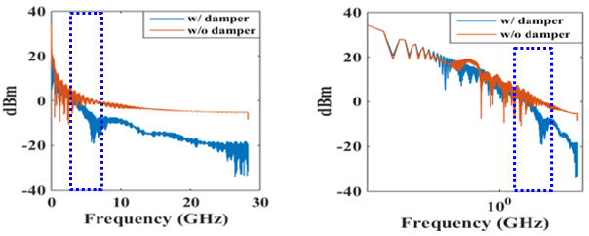
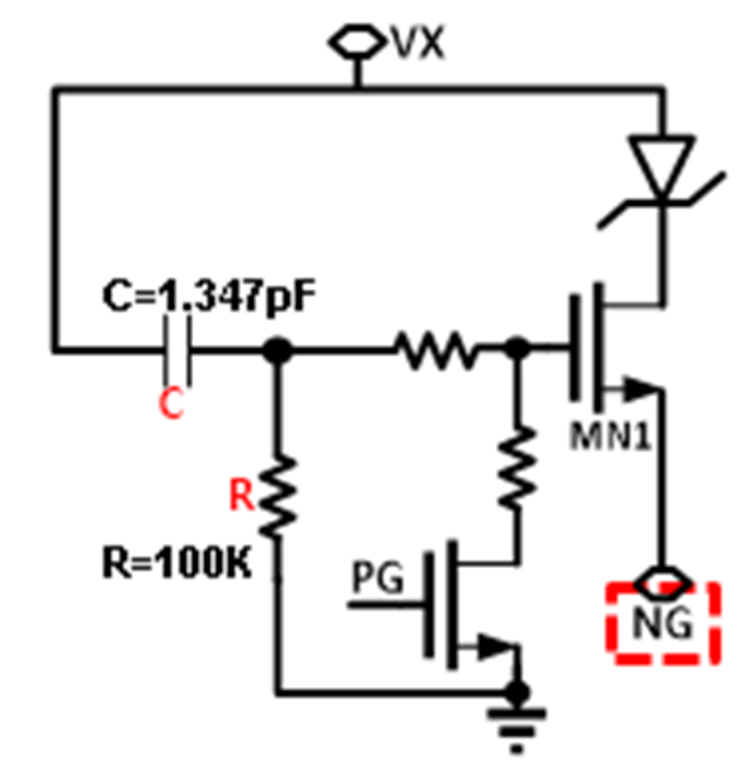
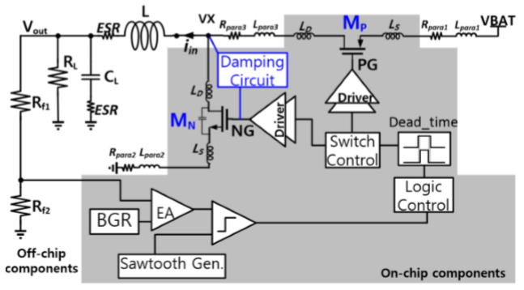
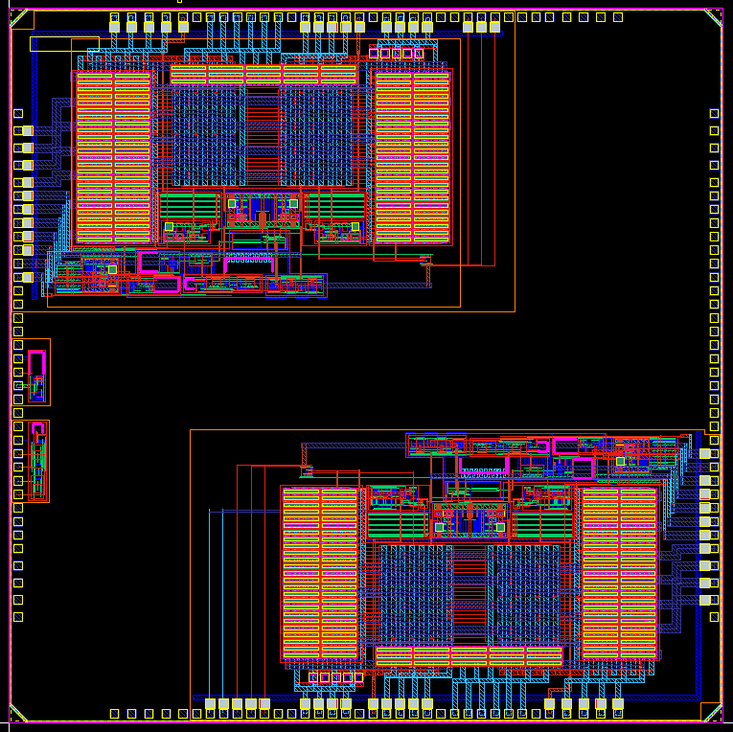
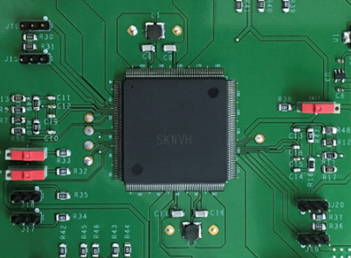
Title: Design for Programmable Slew-rate Controlled Output Stages for Reducing EMI in DC-DC Converter
Author: GiWon Kim, Taewoong Kim, Hoang Nguyen van and SoYoung Kim
Affiliation: College of Information and Communication Engineering, Sungkyunkwan University
Introduction
If an active damping circuit is added, synchronization with the auxiliary switch is required, and it can be adjusted through the slew rate control. The damping circuit can be effectively used only if the correct delay can be checked.
The amplitude of peak voltage at the switching node of the DC-DC converter determines the electromagnetic emission (EMI) that affects noise problem in mobile systems. Active damping circuit is used to reduce this peak voltage. This can lead to an effect through slew-rate control. The proposed method is applied to the buck DC-DC converter and the EMI reduction of 5 dB is shown through simulation results. This design was manufactured using IDEC MPW using DB hitek 0.18μm process.
Simulation Results
Proposed Circuit : Active Damping Circuit
(a) Linear scale on X-axis
(b) Log scale on X-axis
Fig 3. FFT results of switching node voltage
We set the target spec before chip production and verified it by simulation. Fig 3. shows switching node voltage, Fig 3.(a) is in linear scale, Fig 3.(b) is in log scale. Waveforms shows the reduction of 5dB at 2.18GHz with damping circuit. The damping circuits shows more reduction at higher frequencies.
(a) Damping circuit
(b) Over all model of DC-DC converter
Fig 1. Proposed circuit
Conclusion
Fig 1.(a) shows the RC filter based active damping circuit. When NMOS power switch is off in the converter, PMOS(M_{p}) turns on, and V_{x}(switching node) voltage will rise. As V_{x} voltage rises, MN1 will be turned on. At the same time, NMOS power switch will be turned on slightly. Due to the rise of the NG signal, peak point at switching node goes down. As a result, ringing at rising edge will be reduced.
In this MPW design, we implemented active damping circuit to diminish EMI noise from the switching node of buck-boost converter. From post-layout simulation results, we were able to reduced the EMI by 5dB. We successfully taped out the chip, packaged the die, and designed PCB for measurement, but our measurement failed because didn’t carefully design the ESD circuit.
Layout
Acknowledgment
This work was supported by the National Research Foundation of Korea (NRF) grant funded by the Korea government (MSIP) (No. NRF-2017R1A2B2003240). This work was supported by the IC Design Education Center (IDEC).
BUCK-BOOST WITH DAMPING CONTROL
Reference
[1] M. Jin, et al, “Identification of essential Coupling path models for conducted EMI prediction in switching power converters,” IEEE Trans. on Power Electronics, pp. 1795-1803, November 2006
[2] E. Darie. et al., “Modeling EMI problem associated with DC-DC converters,” MIPS 2008, Nov. 2008
BUCK-BOOST WITH DAMPING & SLEW CONTROL
(a) Layout
(b) Test PCB
Fig 2.Top layout
Fig 2. shows the chip layout. We applied the proposed active damping circuit to buck-boost converter.

